Slide 1
Applications using Actor Model
Presenters:
Radu Ciumag
radu.ciumag@endava.com
Marian Matei
marian.matei@endava.com

Slide 2
Applications using Actor Model – Agenda
Actor Model
Fundamental concepts
Implementations
Akka
Benefits
Actors
Supervision
Routers
Dispatchers
Remoting
Drawbacks
Web Crawler

Slide 3
Applications using Actor Model – Agenda
Actor Model
Fundamental concepts
Implementations
Akka
Benefits
Actors
Supervision
Routers
Dispatchers
Remoting
Drawbacks
Web Crawler

Slide 4

Actor Model
What is it
Most certainly, not this
It is a programming model, designed way back in 1973 and came into focus after 2000 when the multi-core computer architecture boosted.

Slide 5
Actor Model
Everything is an Actor (similar to everything is an object in OOP)
An actor has an address and he consumes messages. As response to these messages, he can create new actors, send messages, designate the behavior for the next message.
An actor can communicate only with the actors whose address he has.
The communication between actors is asynchronous.
Avoids concurrent access to mutable state.

Slide 6




Actor model
Implementations – Java, .Net, Python, Scala
Remact.Net
Korus SObjectizer
Nact JActor
Pulsar

Slide 7
Applications using Actor Model – Agenda
Actor Model
Fundamental concepts
Implementations
Akka
Benefits
Actors
Supervision
Routers
Dispatchers
Remoting
Drawbacks
Web Crawler

Slide 8
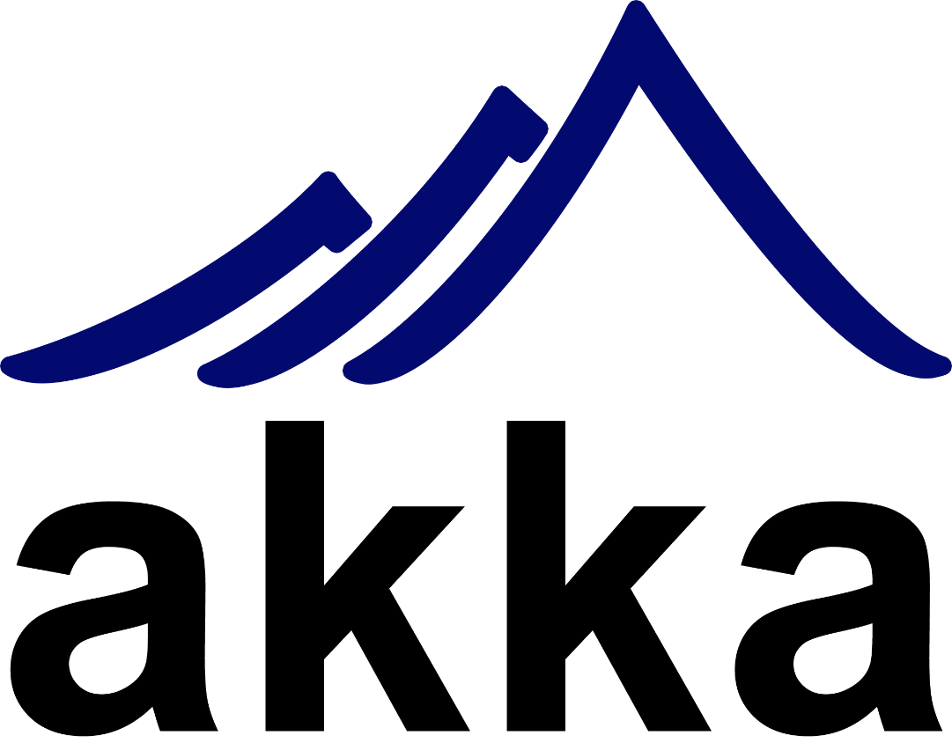
Build highly concurrent, distributed, and fault tolerant event-driven applications

Slide 9
Akka Benefits
Simpler concurrency (scale up)
decouples business logic from low-level mechanisms such as threads, locks and non-blocking I/O
asynchronous messages
Simpler distribution (scale out)
out of the box transparent remoting support
Simpler fault-tolerance (self healing)
based on supervisor hierarchies
resume, restart, stop or escalate

Slide 10
Akka Actors
What are they
Is the smallest unit of the system
Has it’s own “thread” – not a CPU kind of thread
Contains: name, state, behavior, mailbox, children, supervision
Name - uniquely identified by this name and his path
State - counters, listeners, sets of data
- not shared between different actors
Behavior - what the actor does when it receives a certain message, depending on its state

Slide 11
Akka Actors
Mailbox
each actor has only one inbox where senders queue messages
the messages are should be immutable
the messages in the mailbox are treated in the order they are queued. The actors cannot scan for a certain message.

Slide 12
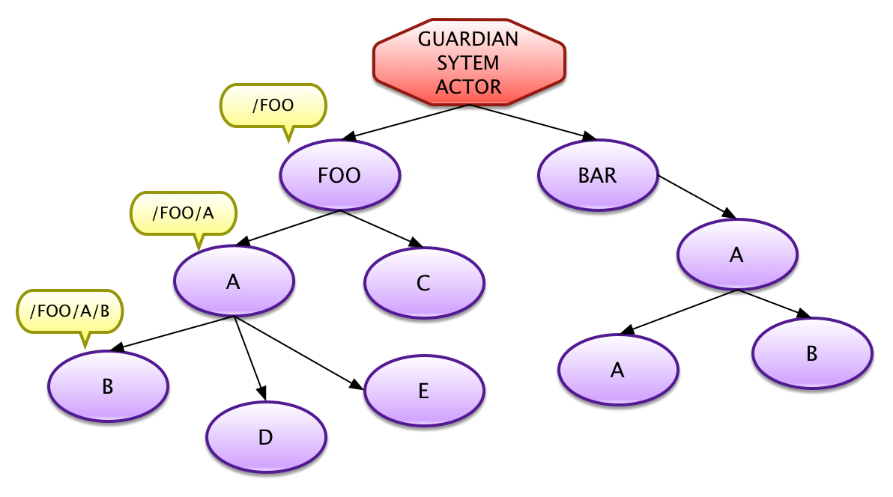
Akka Actors
Children
- every actor is created by
another actor
Supervision
- every actor must take care of the faults of his children

Slide 13
Akka Supervision
Actions in case of failure
Resume the failing actor, keeping the internal state
Restart the failing actor, reinitializing the internal state
Stop the failing actor
Give up and escalate to the supervisor

Slide 14
Akka Supervision - Types
One-For-One
if an actor fails, his siblings will not be affected
All-For-One
if an actor fails, his siblings will share his destiny
network not available, database not responding

Slide 15
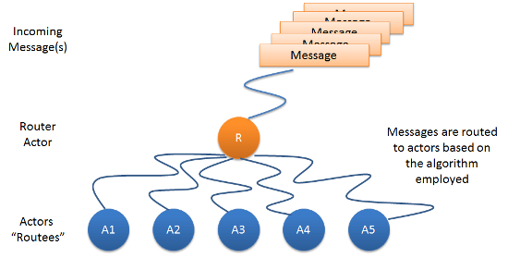
Akka Routers - Definition
A router is a special kind of actor that is sending the messages in a more efficient way to actors he knows.

Slide 16
Akka Routers - Types
Round robin router:
It routes the incoming messages in a circular order to all its routees
Random router:
It randomly selects a routee and routes the message to the same
Smallest mailbox router:
It identifies the actor with the least number of messages in its mailbox and routes the message to the same
Broadcast router:
It forwards the same message to all the routees

Slide 17
Akka Routers - Types
Scatter gather first completed router:
It forwards the message to all its routees as a future, then whichever routee actor responds back, it takes the results and sends them back to the caller
Tail chopping router
Since Akka 2.3.5
Will first send the message to one, randomly picked, routee and then after a small delay to to a second routee (picked randomly from the remaining routees) and so on. It waits for first reply it gets back and forwards it back to original sender. Other replies are discarded.

Slide 18
Akka Dispatchers
Based on the Java Executor framework - execution of asynchronous tasks
Controls and coordinates the message dispatching to the actors mapped on the underlying threads
The application needs to specify which dispatcher policy is used for which actors

Slide 19
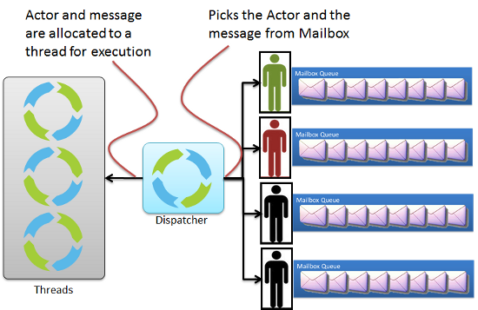
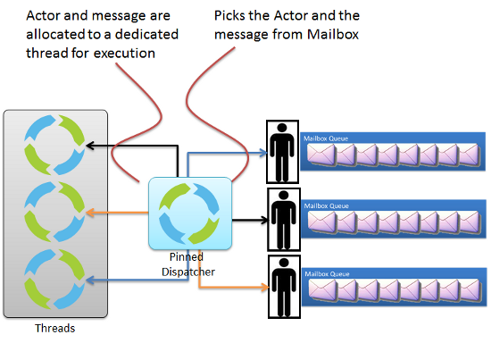
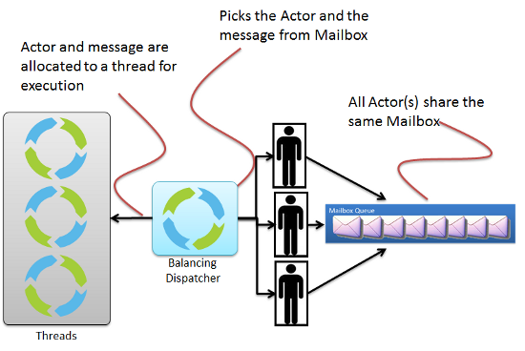
Akka Dispatchers
Dispatcher Pinned dispatcher
Balancing dispatcher

Slide 20
Akka Remoting
Distributed by Default
use purely message passing and everything is asynchronous
all functions are available equally when running within a single JVM or on a cluster of hundreds of machines
Ways in which Transparency is Broken
all messages sent over the wire must be serializable
everything needs to be aware of all interactions being fully asynchronous: network delay, probability for a message to be lost

Slide 21
Akka Remoting
How is Remoting Used?
nearly no API for the remoting layer
purely driven by configuration
Peer-to-Peer vs. Client-Server
Communication between involved systems is symmetric
if a system A can connect to a system B then system B must also be able to connect to system A independently
Not suitable for Network Address Translation or Load Balancers
There is no system that only accepts connections, and there is no system that only initiates connections

Slide 22
Akka Drawbacks
A framework, not a standard
Limited documentation
Backward compatibility issues
Performance overhead
Non-natural integration with dependency injection frameworks
Error handling gaps
Limited availability of monitoring tools

Slide 23
Applications using Actor Model – Agenda
Actor Model
Akka
Web Crawler
Module Scope And Objectives
How AKKA actor system helps
The actors hierarchy
Application data flow
Encountered issues

Slide 24
Source Code and Tools
Build requirements:
JDK 1.7
Maven 3+
Source code:
https://github.com/ActorModelWorkshop/AKKAWorkshop/
Checkout:
Git clone
Download zip using a browser

Slide 25
Module Scope And Objectives
Creating a parallel and distributed system able to read and process the web page content for specific sites using the actor model
Use of Akka actor system as a implementation for the actor model
Evaluate Akka in the specific conditions of web crawl and content processing with emphasis on parallelization
Restrictions:
Do not overload a domain with requests
Create a dynamic lists of domains and links to crawl using the information found in the processed pages

Slide 26
How AKKA actor system helps
Hierarchical structure of actors – used for actor control and supervising
Routers to manage the messages to and from an actor pool
Supervisor strategies to handle exception
Performance and scalability in the context of high traffic message exchange

Slide 27
The actors hierarchy
Actor system root
Master actor
Domains master actor
Processing master actor
Persistence master actor
Download router

Slide 28
Hierarchy – Domains master actor
Domains master actor
Domain actor 1
Download router
…
Domain actor n
Download actor 1
…
Download actor m

Slide 29
Hierarchy – Processing master actor
Processing master actor
Identify links router
Data extractor router
Identify links actor 1
…
Identify links actor n
Data extractor actor 1
…
Data extractor actor m

Slide 30
Hierarchy – Persistence master actor
Persistence master actor
Persistence actor
- handles all persistence requests -

Slide 31
Application data flow
Startup actors creation:
MasterActor
MasterActor will create:
DomainMasterActor, DownloadUrlActor router, ProcessingMasterActor and PersistenceMasterActor
DomainMasterActor requests a list of available domains and starts the new domains, those that are not already started or marked as unresponsive or exhausted. Domains scanning is continuous, using a scheduler.
DomainActor requests a new link to process and downloads content using DownloadUrlActor. The content is processed by the ProcessingMasterActor. Domain links scanning is continuous, using a scheduler.

Slide 32
Application data flow
Content processing in ProcessingMasterActor:
IdentifyLinksActor – extracts all the links available in the content → the result is sent to the persistence layer for storage (handled by PersistenceMasterActor)
DataExtractorActor – extracts the plain text (no html tags) from the content → the result may be sent to an indexing engine (handled by PersistenceMasterActor)

Slide 33
Application data flow
PersistenceMasterActor uses one PersistenceActor to handle all the data operations:
List of the crawl able domains available
Domain data update
New link to crawl for a specific domain
Link data update
Save the newly found link on a page. The persistence layer will assure that a link will not be duplicated.

Slide 34
Encountered issues – Messages
Messages – two ways of sending a message to another actor:
Send the message directly to the actor
Identify the destination actor using a concrete or a relative path
Send the message to the identified actor
FAILED: in a high-load situation, 10’s of thousands or more messages, the actor search will fail to find a result
Send the message to the parent or child
Send the message to the current actors parent or child
The parent or child will process the message or route it to its parent or child

Slide 35
Supervision
DomainMasterActor handles the above exceptions using a OneForOneStrategy
For ExhaustedDomainException
The domain is added in a “exhausted domains” list
The domain status is persisted
The DomainActor that reported the exception is stopped
For UnresponsiveDomainException
The domain is added in a “unresponsive domains” list
The domain status is persisted
The DomainActor that reported the exception is stopped
For any other exception, the actor that reported the exception will be restarted

Slide 36
Thank You!
Web Crawler:
https://github.com/ActorModelWorkshop/AKKAWorkshop/
Akka Documentation:
http://akka.io/docs/
Actor Model:
http://carlhewitt.info/
The Reactive Manifesto:
http://www.reactivemanifesto.org/

